Slide 1


BIG MOUNTAIN RESORT

Slide 2

PROBLEM STATEMENT
How can Big Mountain Resort more accurately price their passes to represent the value of their facilities?

Slide 3

RECOMMENDATION & KEY FINDINGS

Slide 4
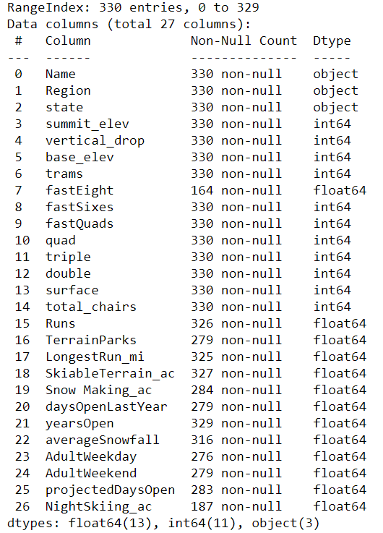

MODELLING PART 1

Slide 5
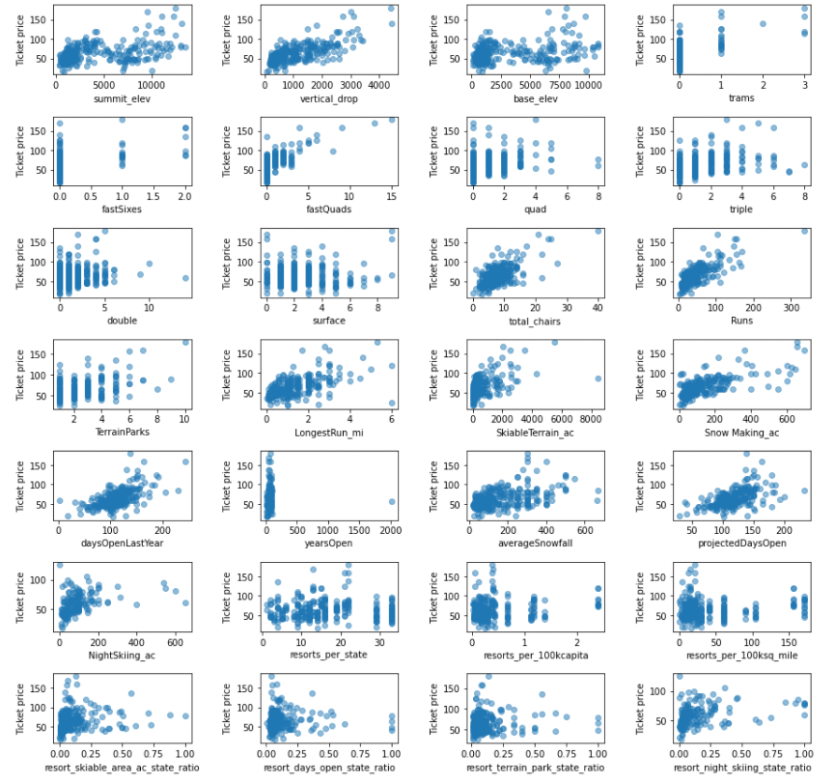

MODELING PART 2

Slide 6

MODELING PART 3

Slide 7

CONCLUSION

